Slide 1
Publications Related to What is an Ontology?
September 13, 2021

Slide 2
Web Pages
http://www-ksl.stanford.edu/kst/what-is-an-ontology.html
Gruber
https://tomgruber.org/writing/ontology-definition-2007.htm
Gruber
http://www.uvm.edu/~edow/ontology.htm
Welty
http://www.cs.man.ac.uk/~stevensr/onto/onto.html
Biomed
…

Slide 3
Papers
https://protege.stanford.edu/publications/ontology_development/ontology101-noy-mcguinness.html
Protege introduction
https://iaoa.org/isc2012/docs/Guarino2009_What_is_an_Ontology.pdf
https://arxiv.org/abs/1810.09171 (”What is an Ontology?”, Neuhaus)
http://ceur-ws.org/Vol-2050/FOUST_paper_13.pdf (“On the Definition of ‘Ontology’, Neuhaus)
Refuting Guarino
https://www.sciencedirect.com/science/article/pii/S2590177X19300010 (“On beyond Gruber", Rector)
Biomed
…

Slide 4
IEEE Issue Related to Ontologies and SemWeb

Slide 5
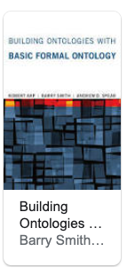
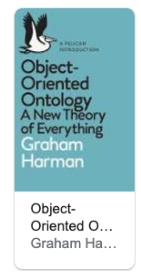
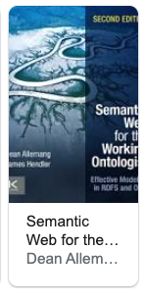
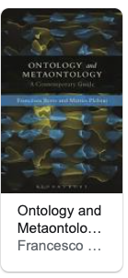
Books
…

Slide 6
Lecture Notes
https://web.stanford.edu/class/cs227/Lectures/lec06.pdf (Chaudhri, Musen)
https://ocw.mit.edu/courses/electrical-engineering-and-computer-science/6-871-knowledge-based-applications-systems-spring-2005/lecture-notes/lect22_ontolog.pdf
In “Knowledge-Based Application Systems”
…

