Slide 1
Events as
Top Level Ontology
March 15 2021
Creative Commons License:
Attribution 4.0 International (CC BY 4.0)
OntoInsights, LLC

Slide 2
.
Event
An event is any situation (including a process or state) that happens, occurs, or holds to be true or false during some time point or time interval.
Stories and the real world have in common that human cognition divides them up into events.
https://urresearch.rochester.edu/fileDownloadForInstitutionalItem.action?itemId=33469&itemFileId=183704
http://ceur-ws.org/Vol-2160/C3GI_2017_paper_1.pdf

Slide 3
.
Aspects of Events
Agents/actors/participants (who and what)
Including affected agents/actors
Location (where)
Time/sequence (when)
Happening/occurrence/state (what)
Tools/instruments/resources used or provided/consumed (what and how)
Goal/intent (why)
Causation, precondition and prevention (why)
Modality+ (planned/possible, attempted/failed, …)
Other relationships
For example, component events

Slide 4
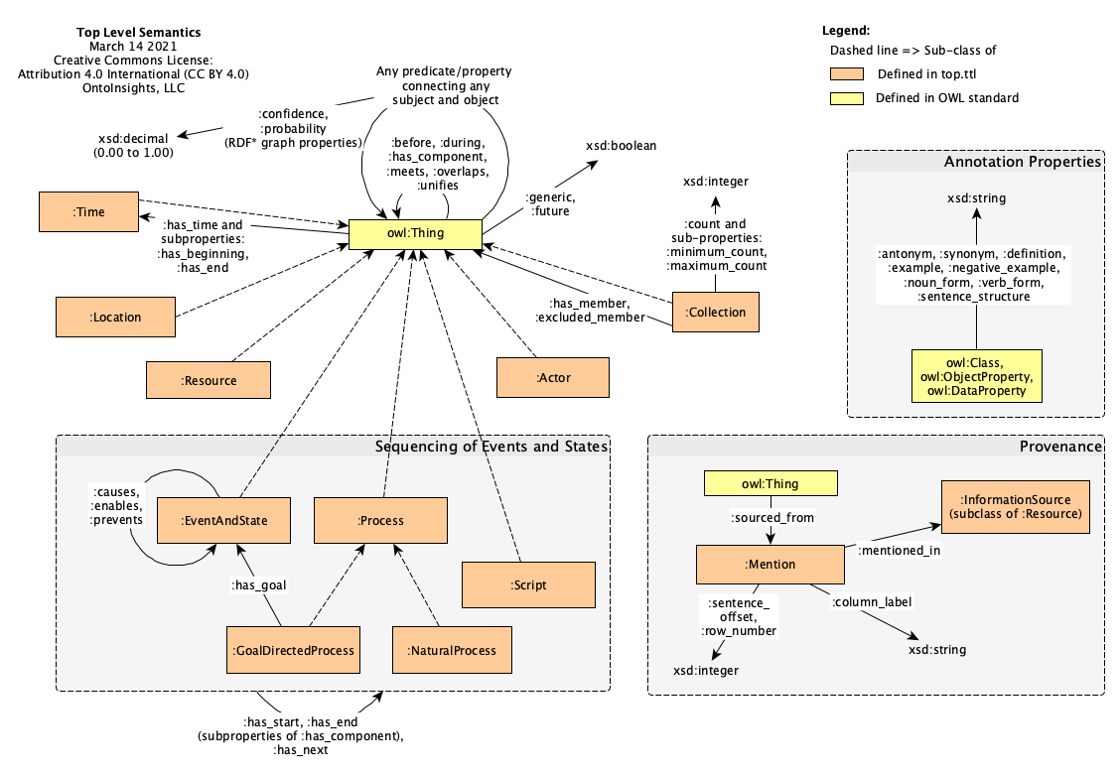
.
‘Top Level’ Ontology - Semantics of Events

Slide 5
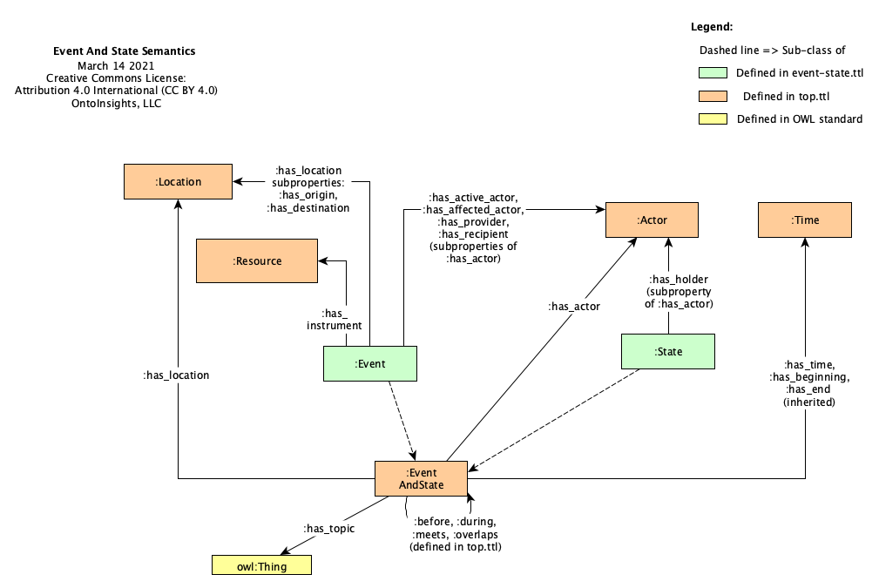
.
Event - State Ontology

Slide 6
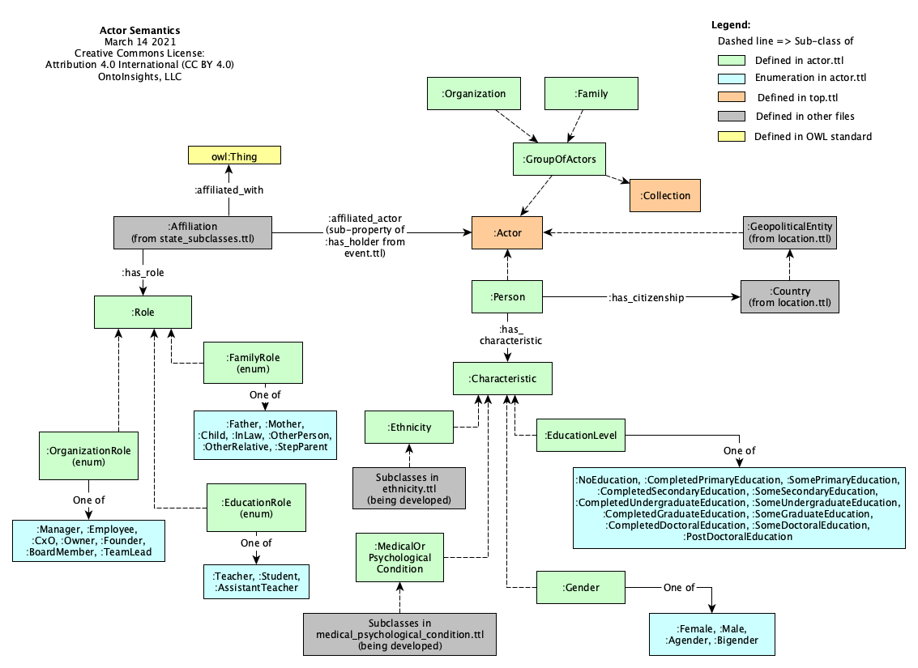
.
Actor/Agent Ontology

Slide 7
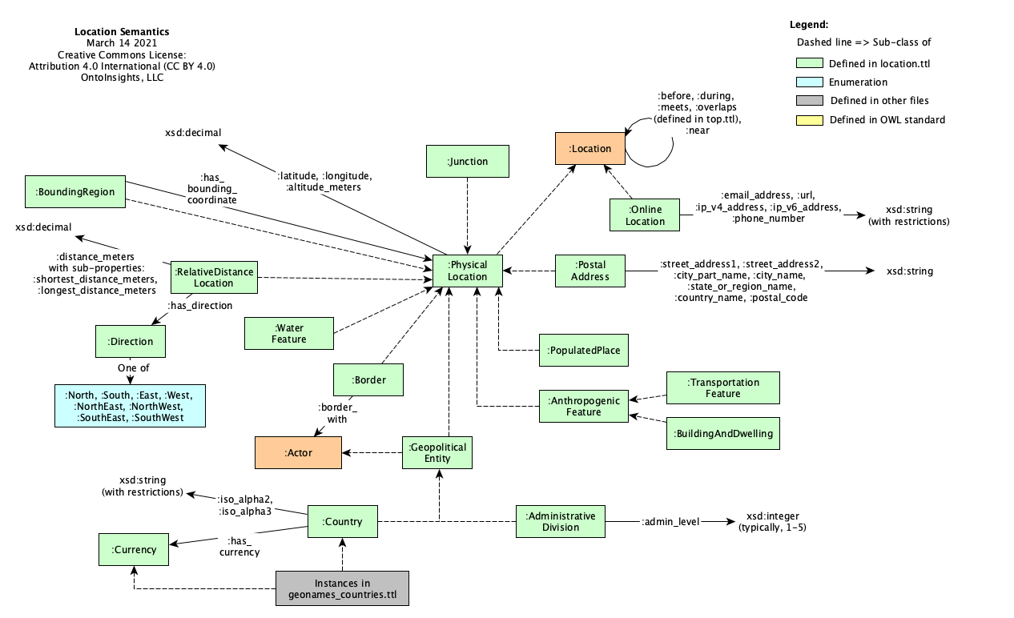
.
Location
Ontology

Slide 8
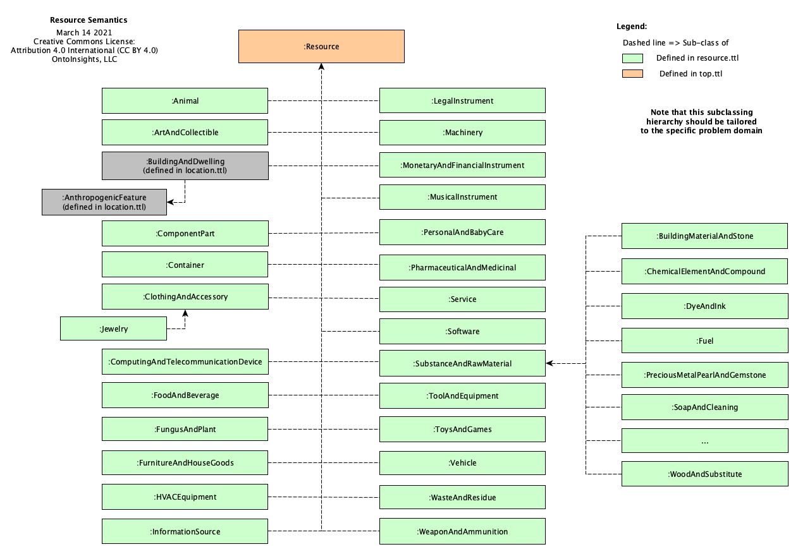
.
Resource
Ontology
Things Created, Used, Required, …

Slide 9
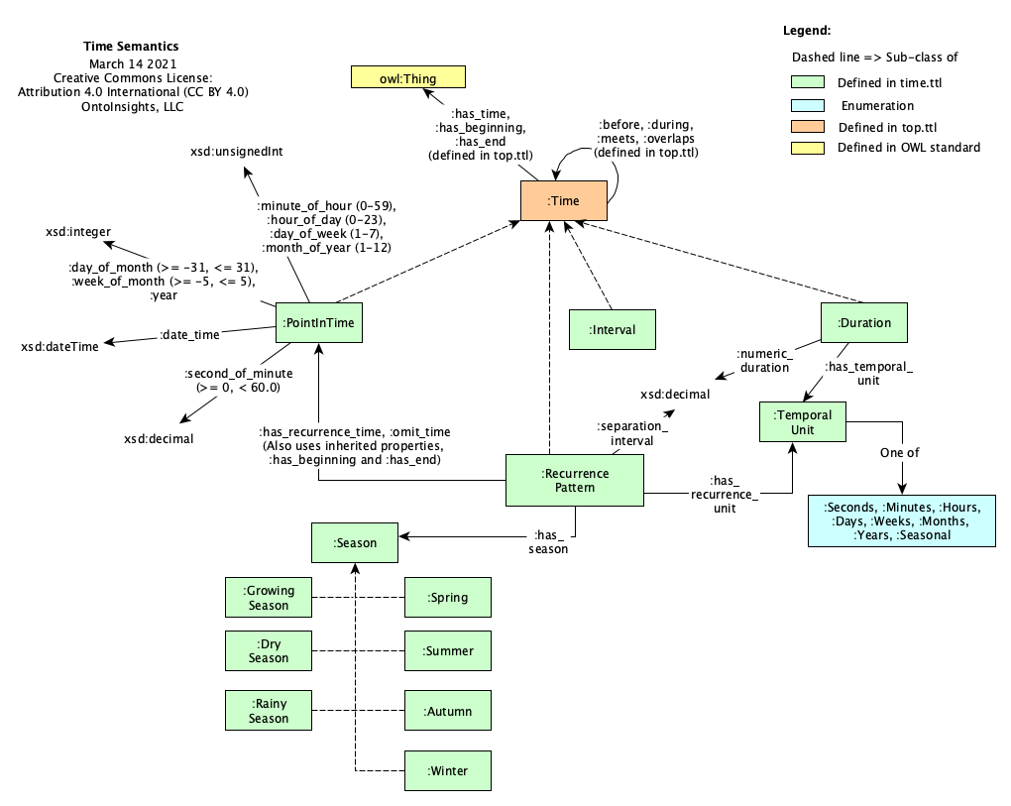
.
Time
Ontology

Slide 10
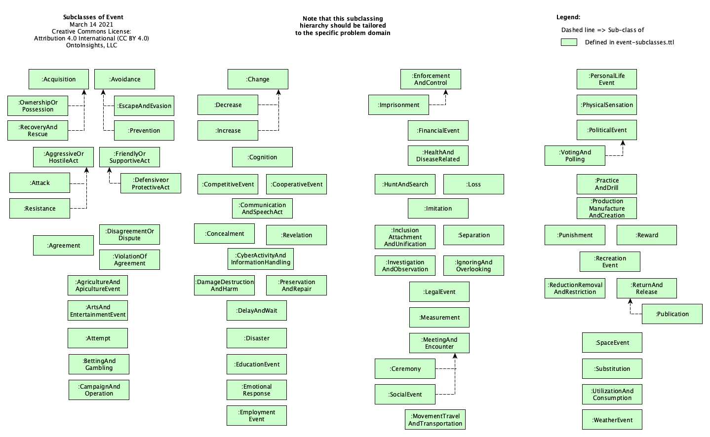
.
Event Sub-Classes

Slide 11
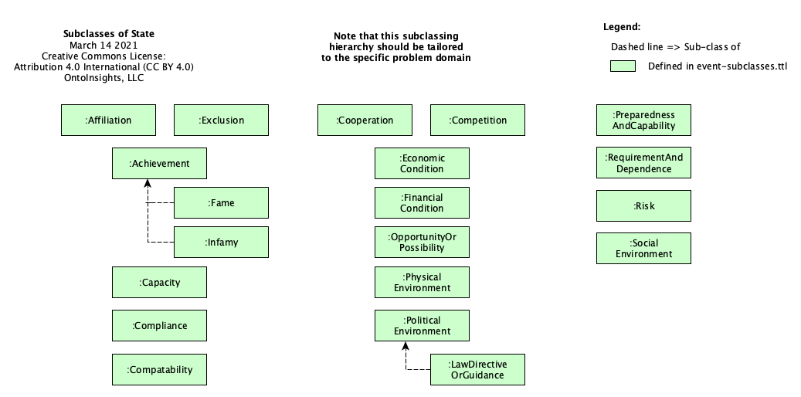
.
State Sub-Classes

Slide 12
CC BY 4.0, OntoInsights, LLC

